Slide 1

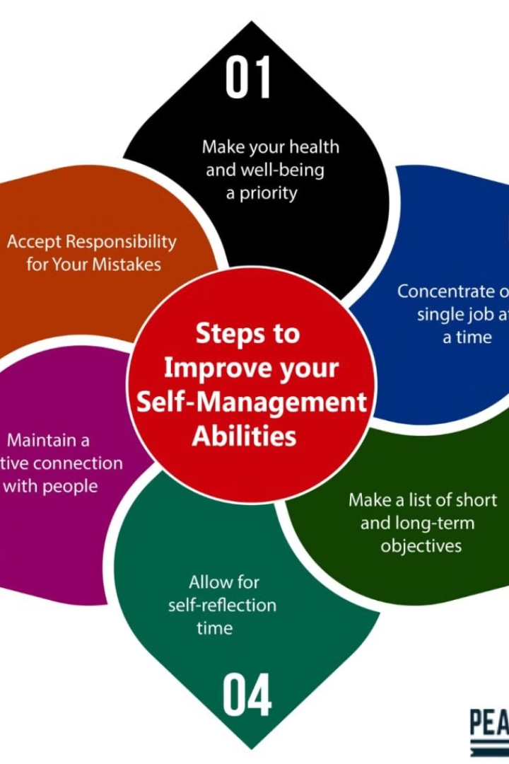
Self Management
Self management is the practice of understanding one's own strengths, weaknesses, and emotions to effectively cope with everyday challenges and lead a balanced life.
BY
Abhijeet Singh Rana
Geeta Jalal
Aashish Yadav
Bharat Joshi
Bharat Upadhyay
Vipin Mathpal
Tarun Nainwal

Slide 2
Importance of Self Awareness
1
Emotional Intelligence
2
Improve Relationships
3
Enhanced Decision Making
Being self-aware enhances emotional intelligence, enabling better understanding and management of one's emotions.
Self-awareness contributes to better communication and stronger relationships, both personally and professionally.
By understanding one's own motivations and reactions, more informed and effective decisions are made.

Slide 3



Strategies for Self Awareness
Mindfulness Practices
Journaling
Feedback Seeking
Engaging in mindfulness exercises and meditation can improve self-awareness and promote emotional regulation.
Reflective writing helps individuals gain insights into their thoughts, emotions, and behaviors, fostering self-discovery.
Soliciting feedback from others facilitates a clearer understanding of oneself and opportunities for growth.

Slide 4
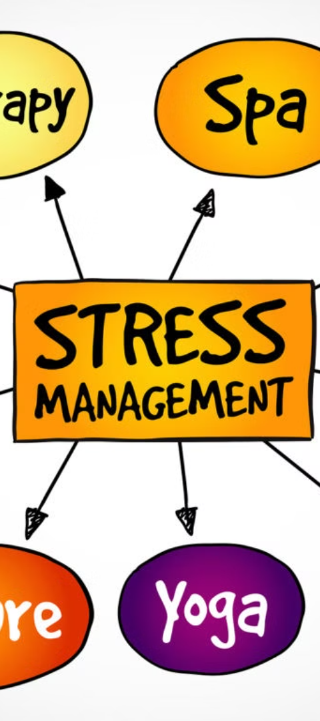
Understanding Stress Management
Impact of Stress
Identifying Triggers
Understanding the detrimental effects of stress on physical and mental health is crucial.
Awareness of stress triggers helps in developing effective coping mechanisms and prevention strategies.
Resilience Building
Learning to build resilience is a key aspect of stress management for long-term well-being.

Slide 5



Techniques for Managing Stress
1
2
3
Deep Breathing
Time Management
Physical Activity
Practicing deep breathing exercises has a calming effect on the mind and body, reducing stress levels.
Effective time management minimizes overwhelm and creates space for stress-reducing activities.
Regular exercise helps in the release of endorphins, aiding in stress reduction and overall well-being.

Slide 6
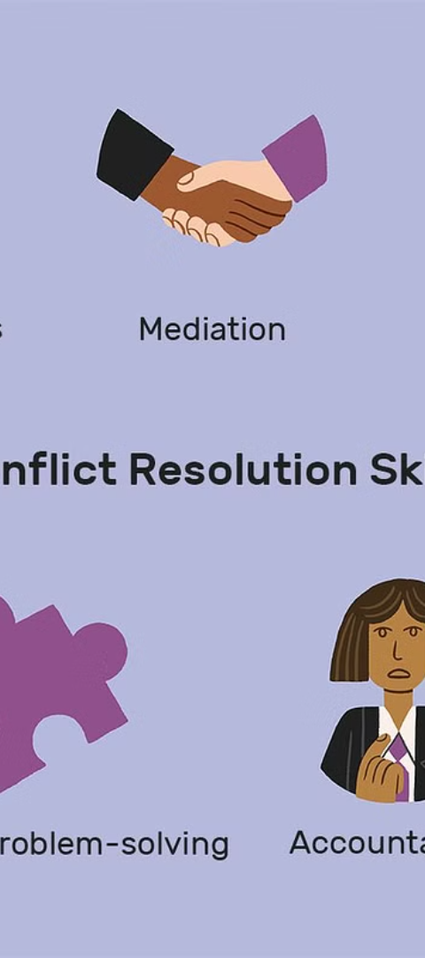
Importance of Conflict Resolution
1
Productive Environment
Efficient conflict resolution fosters a harmonious and productive environment in various settings.
2
Enhanced Communication
It promotes open dialogue and constructive communication, strengthening relationships.
3
Reduced Stress
Effective conflict resolution reduces unwanted tension and stress among individuals or teams.

Slide 7




Strategies for Conflict Resolution
Negotiation
Mediation
Effective Communication
Empathy
Seeking mutually beneficial solutions through negotiation and compromise.
Utilizing a neutral mediator to facilitate discussion and find resolutions.
Understanding and considering the perspectives and emotions of others.
Emphasizing active listening and clear communication to resolve conflicts.

Slide 8
Conclusion and Key Takeaways
Self Awareness
Stress Management
Enhances Emotional Intelligence
Identifying Stress Triggers
Improves Decision Making
Techniques for Stress Reduction
Facilitates Better Relationships
Reduces Unwanted Tension

Slide 9

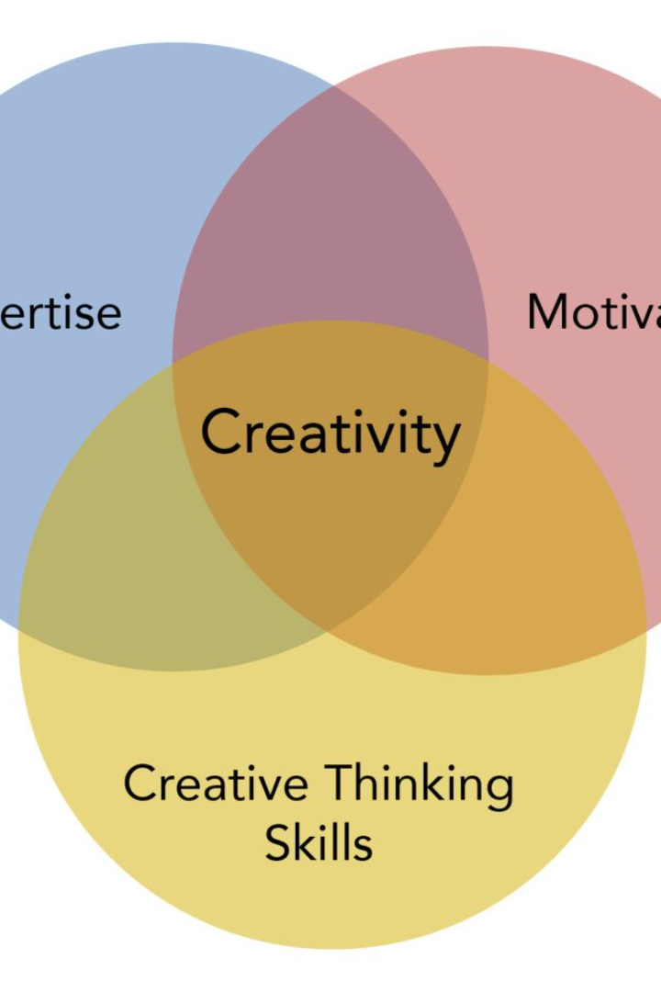
Introduction to Creativity and Innovation
A fundamental understanding of the relationship between creativity and innovation is crucial for any individual or organization striving for growth and success. Creativity is the ability to generate new ideas, while innovation involves turning those ideas into reality. Both are essential for progress and development.

Slide 10

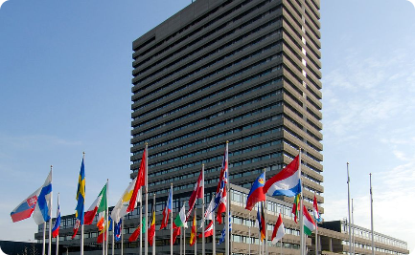

Importance of Intellectual Property Rights
Understanding Intellectual Property Rights
Types of Intellectual Property Rights
Copyright Protection
Copyright protects original creations like books, movies, music, and software from unauthorized reproduction and distribution.
Intellectual property rights are crucial for protecting creations like inventions, literary and artistic works, designs, symbols, names, and images.
These rights encompass patents, copyrights, and trademarks, ensuring legal ownership and exclusive usage of intellectual creations.

Slide 11

Understanding Intellectual Property Rights
1
Creative Expression
2
Exclusive Rights
Intellectual property rights safeguard the expressions of ideas in various forms, including literary, artistic, and scientific works.
Owners have exclusive rights to use, reproduce, and distribute their creations, which promotes continued innovation and creativity.
3
Legal Protection
Intellectual property laws provide a legal framework to protect creators and encourage investment in knowledge-based industries.

Slide 12

Copyright Protection
1
Ownership
Upon creation, copyright protection is automatic, giving the creator or author exclusive rights to their work.
2
Duration
Copyright protection typically lasts for the creator's lifetime plus an additional 70 years.
3
Enforcement
Courts can enforce copyright protection, allowing creators to pursue legal action against infringement.

Slide 13

Patent Protection
Innovation Encouragement
Technical Disclosure
Patents incentivize innovation by providing inventors with exclusive rights to their creations for a limited period.
Patents require detailed disclosure of the invention, contributing to the public knowledge base and enabling further innovation.
Legal Recourse
Owners can take legal action against patent infringement, protecting their inventions from unauthorized use or reproduction.

Slide 14
Trademark Protection
Brand Recognition
Consumer Protection
Business Assets
Trademarks like logos and slogans distinguish products and services, enabling consumers to identify and trust specific brands.
Trademarks prevent confusion among consumers, ensuring they are getting the products or services they expect.
Trademarks are valuable business assets, often appreciating over time and contributing to a brand's overall worth.

Slide 15


Enforcing Intellectual Property Rights
Legal Action
Justice System
Monitoring
Enforcing rights may involve legal action against individuals or entities infringing on intellectual property.
The justice system plays a crucial role in upholding and enforcing intellectual property laws.
Constant monitoring and protection are essential to prevent unauthorized use of intellectual property.

Slide 16
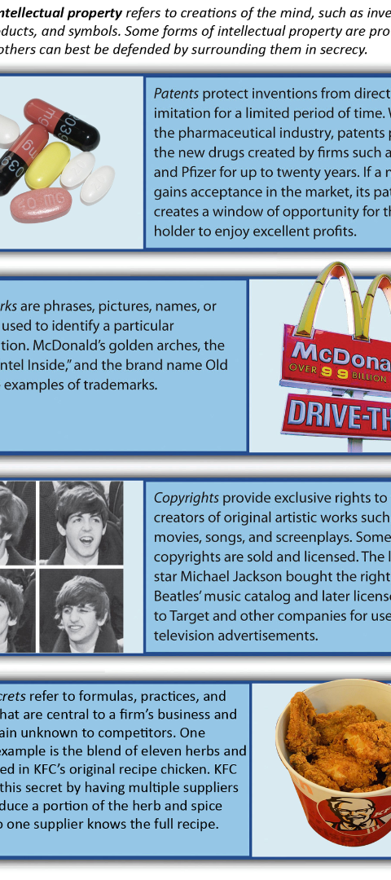



Impact of Intellectual Property Rights
Innovation Promotion
Intellectual property rights encourage and reward innovation, driving technological and artistic advancements.
Economic Growth
Strong intellectual property protection fosters economic growth by incentivizing investment in creativity and innovation.
Consumer Benefits
Consumers benefit from enhanced product qualities and choices resulting from sustainable innovation fueled by intellectual property protection.

